Slide 1
Math + SRBI:
Adding It Up
Cay Freeman, Math Intervention Teacher
Sage Park Middle School, Windsor
&
Clare Wurm, SERC Consultant

Slide 2
Schedules and Structures
SRBI are systemic
General ed teachers
Special ed teachers
Administrators
Families
Specialists, interventionists, psychologists, paraeducators, etc.

Slide 3
BASIC PRINCIPLES AND FEATURES OF SRBI:
Prevention and early intervention
High quality curriculum
Monitoring fidelity of implementation
Comprehensive assessment plan
Data-driven decision making
Notes:
Taken from the 10 basic principles and key features
Lots of overlap—systems approach so all are intertwined

Slide 4
Focus on prevention and early intervention
Applicable at all ages
Requires timely assessment and flexible intervention scheduling
High-quality Tier I instruction
Notes:
Not just pre-school students.

Slide 5
High quality curriculum and instruction
Connecticut Core Standards
Cohesive district-wide curriculum
Evaluations of curriculum and instruction

Slide 6
Monitor fidelity of implementation
Both classroom and intervention
Evaluators need to know what to look for
Peer observations

Slide 7
Comprehensive assessment plan
Universal Common Assessments
Administered periodically (3x per year)
Given to all
Predict success on standardized tests

Slide 8
Comprehensive assessment plan
Progress Monitoring
Reliable & valid,
Easy to Administer
All tiers
Tier I: Common Formative Assessments throughout course
Tier II: more frequent – weekly or biweekly
Tier III: most frequent – twice per week

Slide 9
Common Math Assessments
Assessment | Company | Grades
aimsweb | Pearson | K-12
MAP | NWEA | K-12
STAR Math | Renaissance Learning | 1-12
PLUS Teacher-created assessments

Slide 10
Data-driven decision making
Teams
Grade-level/content
School-wide
District-wide

Slide 11
Data-driven decision making
Different types of data are needed to make informed decision
One data point should not dictate action—need triangulated data
Data includes information beyond test scores– teachers, counselors, paraprofessionals, administrators, parents, and students can all provide useful data

Slide 12
Data-driven decision making
Collecting the data is not enough. Data must be analyzed, interpreted, and acted upon.
Grades 9-12 Initial Math Intervention Considerations
https://tnlweb.madison.k12.wi.us/files/tnl/Literacy%20and%20Math%20Flowcharts%20K-12%20Final_Aug_2014%20(4).pdf
Notes:
*Will add examples of intervention flow charts/Team forms/checklists

Slide 13
SRBI & Math in action
Cay Freeman, Math Intervention Teacher
Sage Park Middle School, Windsor

Slide 14
SRBI SYMPOSIUM III Fall, 2015
SRBI + Math:
Adding It Up
Cay Freeman
Math Intervention Teacher
Sage Park Middle School, Windsor

Slide 15
Goals for this session: Participants will….
Learn critical factors to consider when planning and making ongoing adjustments to teaching to ensure student achievement
Learn promising instructional practices targeting Tier 2 and Tier 3 math students, with supporting research basis
Learn about resources to aid in your SRBI efforts

Slide 16
My “Go-to”
Resource for
Math SRBI:
http://ies.ed.gov/ncee/wWc/pdf/practice_guides/rti_math_pg_042109.pdf

Slide 17
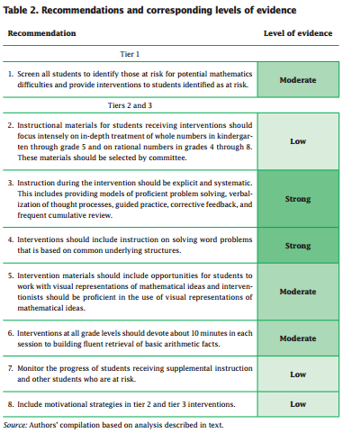
Each recommendation includes:
Brief Summary
How to carry out
the recommendation
3. Potential roadblocks
and solutions

Slide 18
Recommendation 2:
Instructional materials should focus intensely on in-depth treatment of:
Grades K-3:
Number sense
Place value
Operations with whole numbers
Grades 4-8:
Use an understanding of whole numbers to build a conceptual framework and work with rational numbers
Cover fewer topics in more depth and with purposeful coherence
Intervention curriculum should not be over-simplified

Slide 19
Should my SRBI program be aligned to the core curriculum?
Instruction should build students’ foundational proficiencies.
Instruction often focuses on prerequisite skills that allow the student to access the general curriculum.
Instruction is determined by the student’s rate of progress.

Slide 20
Recommendation 3:
Instruction should be systematic:
introduce concepts in a logical order using logical numbers
explore multiple methods to arrive at the solution
provide students with numerous applications of each concept and skill
demonstrate proficient problem solving with sufficient models

Slide 21
Recommendation 3:
Instruction should be explicit:
Verbalization of the thought processes and the reasons behind math procedures, formulas, and problem-solving methods
Teachers should be knowledgeable enough to anticipate and address misconceptions
Include numerous clear models of easy and difficult problems, with accompanying teacher think-alouds
What are we preparing our students for?

Slide 22
Explicit Instruction includes:
Guided, scaffolded, extensive practice
Students communicate the strategies they are using to solve problems and provide reasons for their decisions
CCSS Math Practice #3: “Construct viable arguments and critique the reasoning of others.”
Teachers provide immediate, specific, actionable corrective feedback with opportunities to correct errors (with guidance, as needed)
Frequent, cumulative review

Slide 23
Conceptual Understanding:
Teach more than just how to get the answer. Instead support students’ ability to access concepts from a number of perspectives.
Students see math as more than a set of mnemonics or discrete procedures. Math should make sense!
Assessment should allow students to access concepts from a number of perspectives to show deep understanding and allow error analysis.

Slide 24
Developing Conceptual Understanding:
Even more important in SRBI classes than Tier 1!
Without conceptual understanding, procedures are a just a recipe and are applied arbitrarily and often in error.
Explicitly connect prior knowledge and skills.
Focus on the process, not the product:
Ask not: What was your answer? (Product)
Ask: What was your thinking? (Process)

Slide 25
Sample Assessment Questions:
For your cousin’s birthday, you buy a videogame that cost $52.99 and a book that costs $17.99. The sales tax rate is 6.2%. How much do you have to pay at the check-out? (Procedural skill)
Jon buys sneakers that cost $75 and goes up to the cash register and gives the cashier $75 for the sneakers and $0.06 for the 6% tax. Is Jon correct? Explain your answer. (Conceptual understanding)

Slide 26
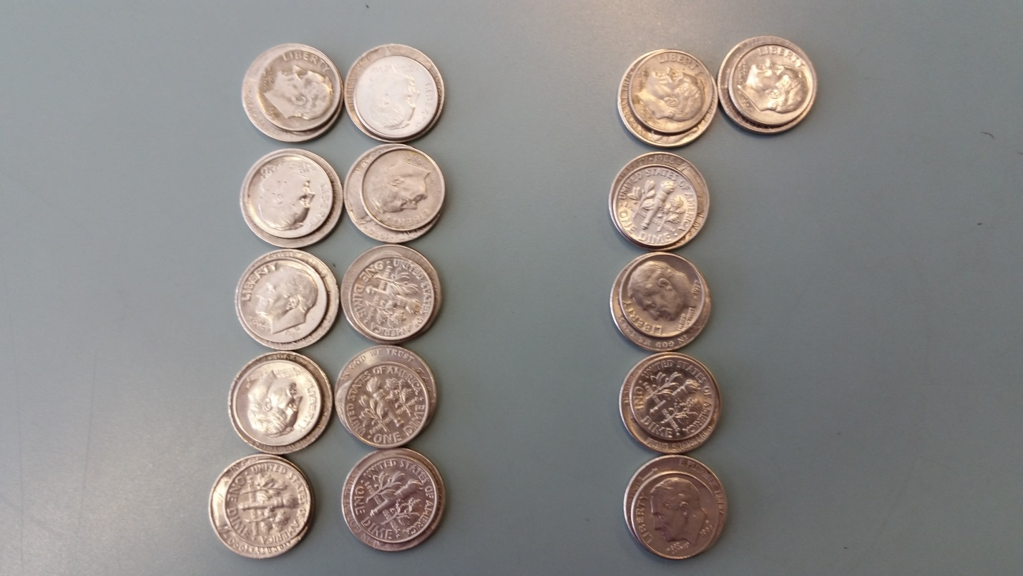
Sample Assessment Questions:
I went out to eat at Friendly’s and decided to leave a 15% tip. If I left this money for a tip, how much did my food cost? Explain your reasoning.

Slide 27
Aligns with CCSS Math Shifts:

Slide 28
Aligns with NCTM:
February, 2104
Growth Mindset!
CCSS Math Practice #1: Make sense of problems and persevere in solving them.

Slide 29
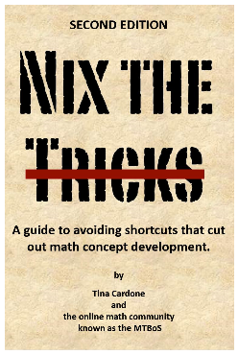
No tricks, and little memorizing!
http://nixthetricks.com/
Develop conceptual understanding
Comprehension of procedures/algorithms
Procedural skill and fluency

Slide 30
Foster a Growth Mindset!
We must help our students build persistence!
Sal Khan’s Words of Wisdom
The Learning Myth:
Why I’ll Never Tell My Son He’s Smart
https://www.khanacademy.org/about/blog/post/95208400815/the-learning-myth-why-ill-never-tell-my-son-hes

Slide 31
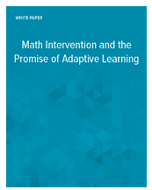
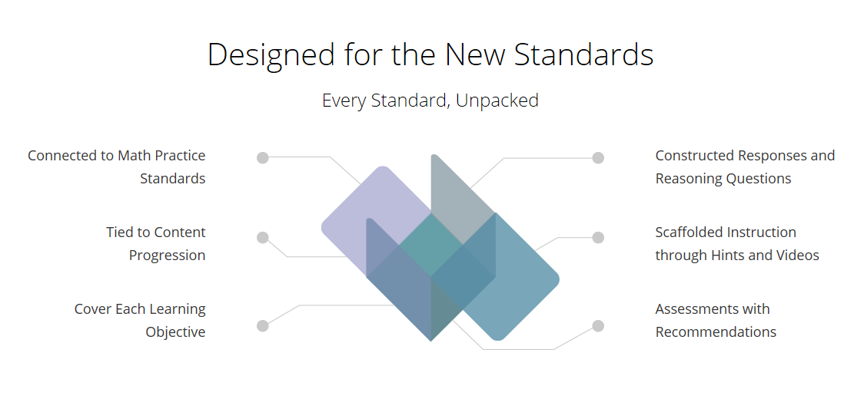
Individualized, Extensive Practice with Corrective Feedback:
https://www.tenmarks.com/
Grades K-8 and
HS Intervention
http://www.dreambox.com/math-intervention
Grades 1 – Algebra 2 and Geometry

Slide 32
Recommendation 4:
Interventions should include instruction on solving word problems that is based on common underlying structures.
Teach students how to categorize problems based on their structure and determine a solution method appropriate for that underlying structure.

Slide 33
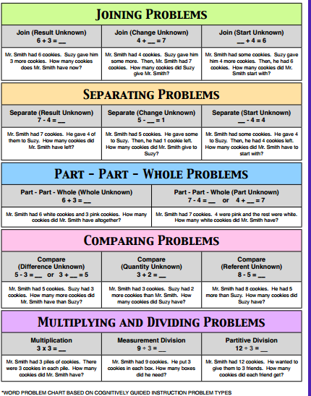
Math Story Problem Types:
http://www.teachertipster.com/
CGI_problem_types.pdf

Slide 34
ADDITION
MULTIPLICATION
I have to find
the total
NOT EQUAL GROUPS
EQUAL GROUPS
SUBTRACTION
DIVISION
NOT EQUAL GROUPS
I know
the total
EQUAL GROUPS

Slide 35
GREAT RESOURCE!
http://ies.ed.gov/ncee/
wwc/pdf/practice_guides/
mps_pg_052212.pdf

Slide 36
Recommendation 5:
Visual representations such as
number lines,
number bonds,
strip diagrams/bar models,
concrete drawings,
and other forms of pictorial representations help scaffold learning and pave the way for understanding the abstract version of the representation.

Slide 37
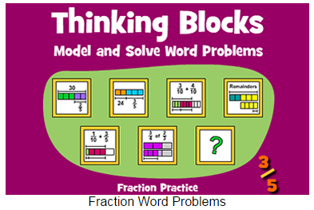
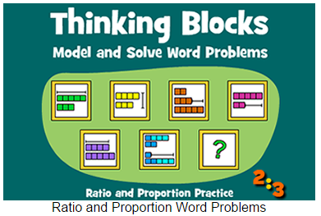
Thinking Blocks: Visual Models
http://www.mathplayground.com/thinkingblocks.htm

Slide 38
Visual Representations
Intervention materials should provide opportunities for students to work with visual representations of mathematical ideas.
Interventionists should be proficient in the use of visual representations of mathematical ideas.
Strong evidence of effectiveness!
http://ies.ed.gov/ncee/wwc/PracticeGuide.aspx?sid=16

Slide 39
The CRA Progression
Research indicates that using manipulatives is especially useful for teaching low achievers, students with learning disabilities, and English language learners. (Marsh and Cooke, 1996; Ruzic and O’Connell, 2001)
Interventionists should allow students to continue to use manipulatives to demonstrate their understanding in the representational and abstract stages, if needed.
https://www.hand2mind.com/pdf/learning_place/research_math_manips.pdf

Slide 40
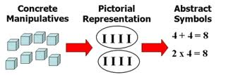
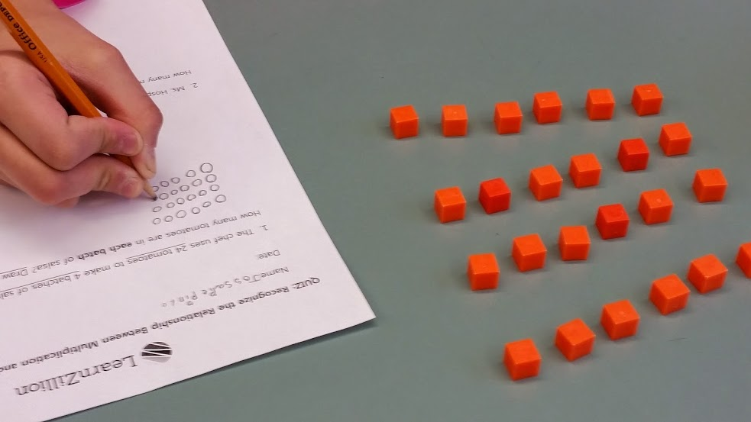
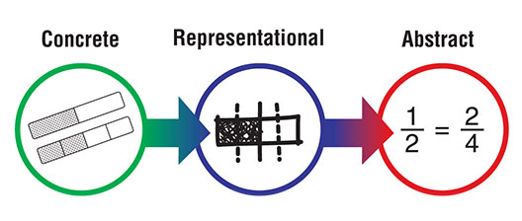
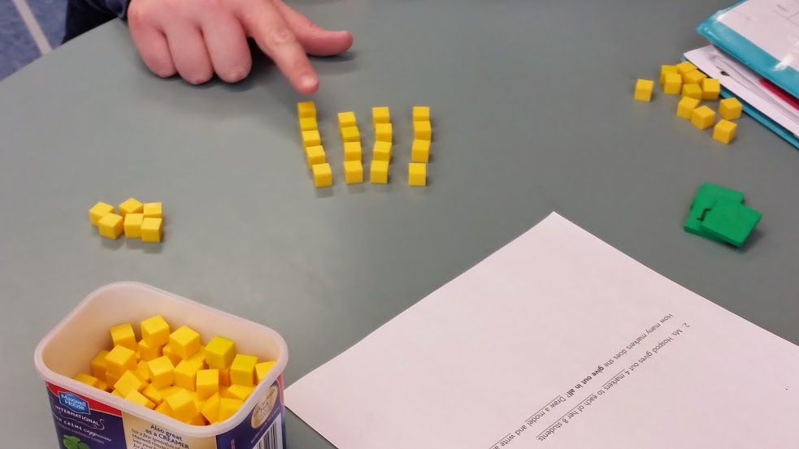

Slide 41
Virtual Manipulatives Resources!
Glencoe/McGraw Hill: (K-8) http://www.glencoe.com/sites/common_assets/mathematics/ebook_assets/vmf/VMF-Interface.html
Houghton Mifflin Harcourt: (Intermediate) https://www-k6.thinkcentral.com/content/hsp/math/mathinfocus/common/itools_int_9780547673844_/main.html
Virtual Algebra Tiles: (HS) http://media.mivu.org/mvu_pd/a4a/homework/index.html
Math Manipulatives Resource Page: Deubel, P. (2015). Math manipulatives: Virtual manipulatives on the web. Retrieved 10/30/15 from Computing Technology for Math Excellence Web site: http://www.ct4me.net/math_manipulatives_2.htm

Slide 42
Scaffold Support:
Scaffolding supports students to reach new heights…
But eventually the scaffolding must come down.

Slide 43
Recommendation 6:
Interventions at all grade levels should devote about 10 minutes in each session to building fluent retrieval of basic arithmetic facts.
Quick retrieval of basic math facts is critical for success in mathematics.
Weak ability to fluently retrieve math facts impedes later understanding of rational number concepts.

Slide 44
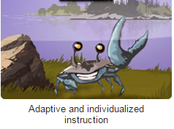
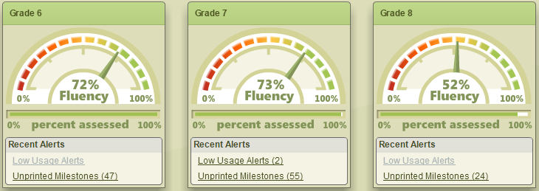
Research-based Fact Fluency:
http://www.reflexmath.com/home

Slide 45
Another Fact Fluency Program:
http://teacher.scholastic.com/math-fact-fluency/fastt-math-next-generation/

Slide 46
CCSS Math Practices for ALL Students:

Slide 47
So How do We Get There?

Slide 48
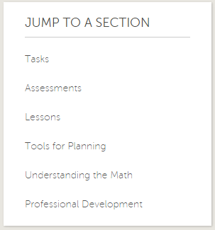
Professional Resources:

Slide 49
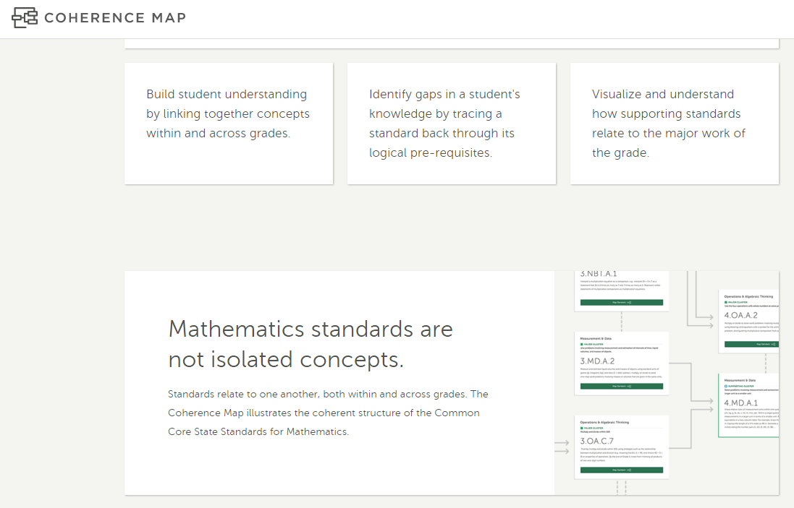
CCSS Coherence Map
http://www.achievethecore.org/coherence-map/

Slide 50
Resources: What Works Clearinghouse
http://ies.ed.gov/ncee/wwc/default.aspx

Slide 51
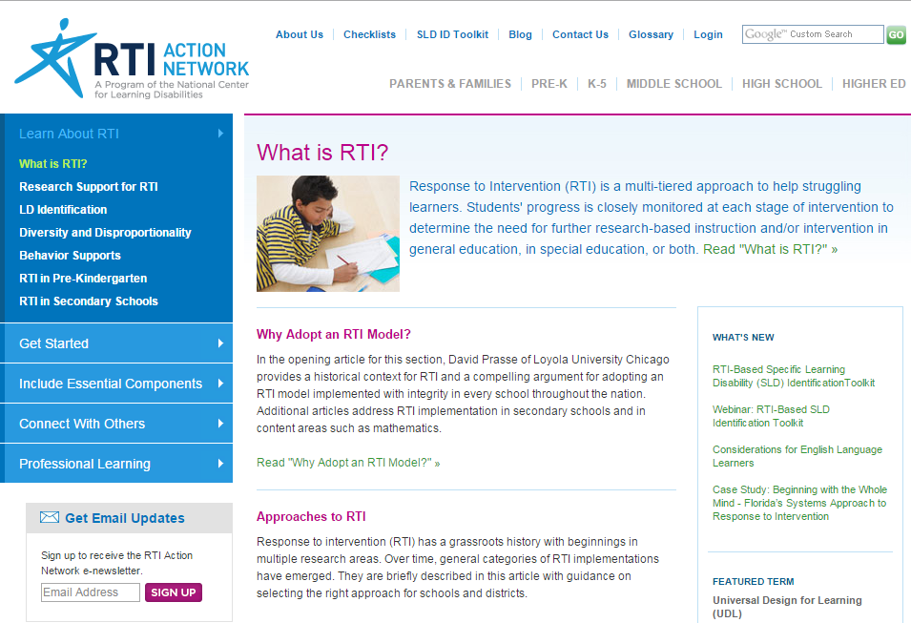
Resources: RTI Action Network
http://www.rtinetwork.org/learn/what

Slide 52
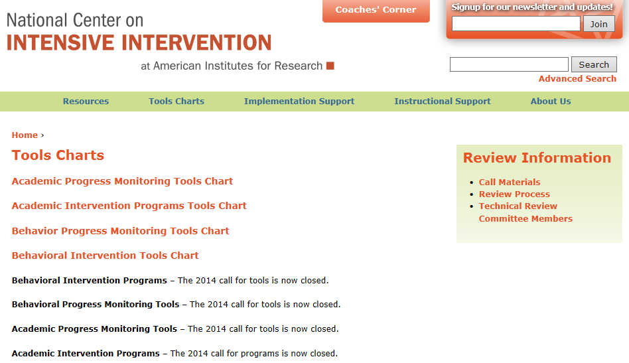
Resources: National Center on Intensive Intervention
http://www.intensiveintervention.org/resources/tools-charts

Slide 53
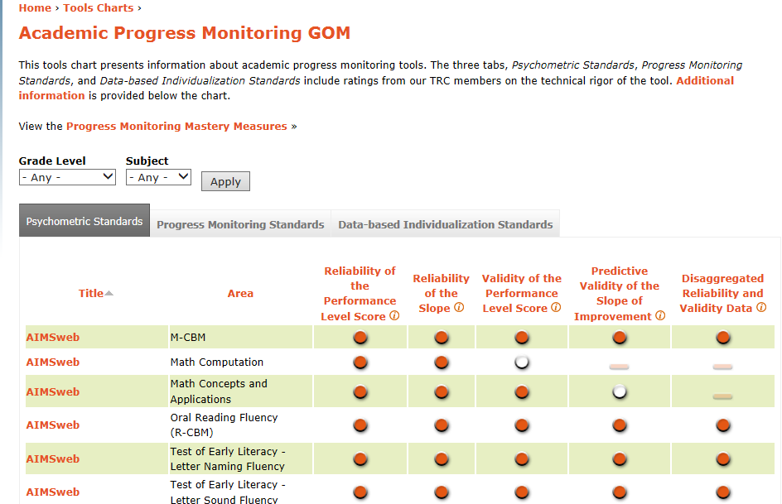
Resources: National Center on Intensive Intervention - Tools Chart

Slide 54
RTI Implementer Series Self-paced Learning Modules
http://www.rti4success.org/rti-implementer-series-self-paced-learning-modules

Slide 55
Renaissance Learning: Accelerated Math
http://www.renaissance.com/products/accelerated-math

Slide 56
LearnZillion.com
https://learnzillion.com/resources/17132

Slide 57
Marilyn Burns’ Do the Math Now!
http://teacher.scholastic.com/products/dothemath/dtmn_structure.htm

Slide 58
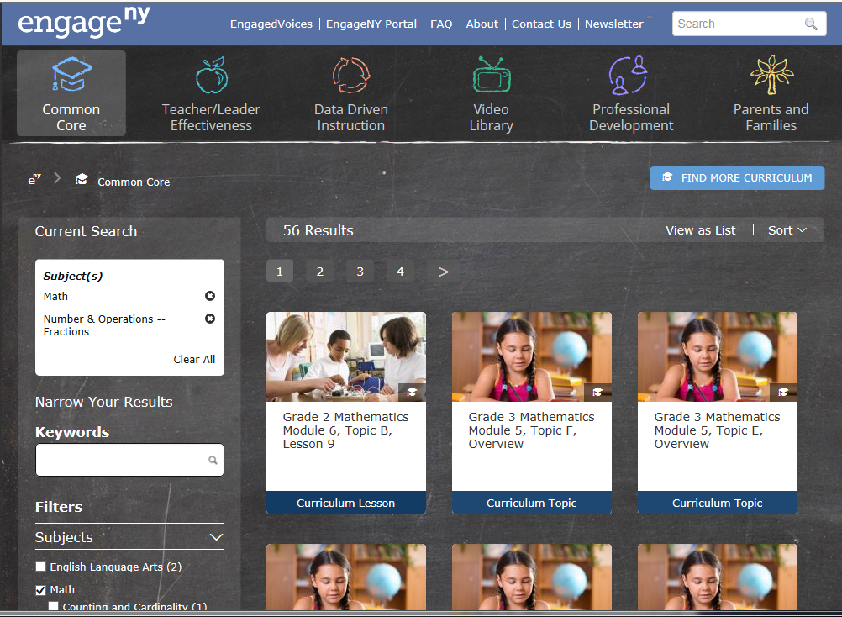
Engage NY.org

Slide 59
CT SDE SRBI Resources:
http://www.sde.ct.gov/sde/cwp/view.asp?a=2618&q=322020

Slide 60
Persist by Ron F. Ferguson, Ph.D.
There is no greater frustration
than to be stubbornly misunderstood
by a child who is afraid that she can’t learn.
And there is no greater elation
than when the light of understanding
burns away the fear and makes her smile return.
April, 2000

Slide 61
Contact information:
Email: cfreeman@windsorct.org
Twitter : @CayFreeman

Slide 62
QUESTIONS?

Slide 63
Resources
CCS Math “Look Fors” Flipbook –guide for core math instruction http://www.sde.ct.gov/sde/lib/sde/pdf/backtoschool/ccss_principal_look_fors_flipbook.pdf
Center on Response to Intervention at American Institutes for Research http://www.rti4success.org/
Intervention Central –tools & resources
http://www.interventioncentral.org/home
The What Works Clearinghouse: Instructional methods and materials http://www.ies.ed.gov/ncee/wwc

Slide 64
Contact us or visit the SERC Library
Clare Wurm, Consultant, SERC
tel: 860-632-1485, x 383
email: wurm@ctserc.org
SERC LIBRARY offers more than 10,000 resources: www.ctserc.org/library
Books
Instructional materials
Tests
Journals
Online databases
DVDs, videos, CD-ROMs
Professional development materials for staff
Notes:
Thank you for spending the day with us.
Please remember to fill out an evaluation, your input strengthens our offerings.
Please feel free to contact us or to visit our Library if you need further resources.

